Slide 1

OPSEC for Mobile
Your devices are plotting your death

Slide 2
About this talk
Not a BYOD talk.
Why encryption and anti-virus isn't enough.
What is OPSEC?
Notes:
Sick of BYOD Talks
Counted 60+ BYOD Webinar Invites
Seen at least 1 if not 2 BYOD talks scheduled at every con I go to.
No documented breaches of organizations.
When I first pitched this talk it was before the NSA revelations, and before DEF CON
Cell Phones and Tablets are extremely powerful small computers we carry with us.
More powerful hardware than computers I owned and used 5 years ago.
HTC One 1.7 GB Quad Core Proc 2GB Ram 32GB Internal Drive w/expandable memory
The OPSEC process is a systematic method used to identify, control, and protect
critical information

Slide 3

Step 1: Identify your data
Notes:
No particular order
What kind of data are you storing?
Contacts
Calendar/Task Items
Email
Text Messages
Files

Slide 4
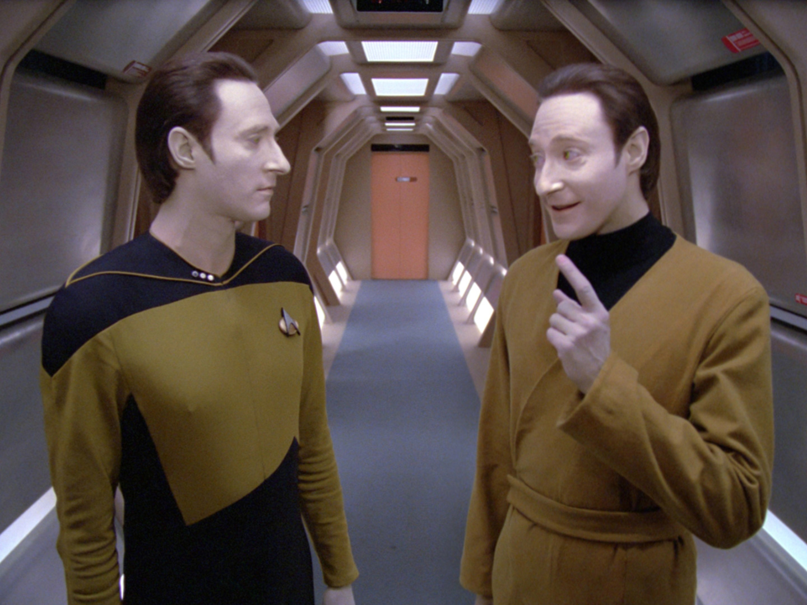
What types of data are you storing?
Notes:
Do some classification on your data.
Determine how sensitive it is

Slide 5

Where are you storing it?
Notes:
Are you storing it in the magical cloud?
Internal Storage on the Phone?
SD Card?

Slide 6
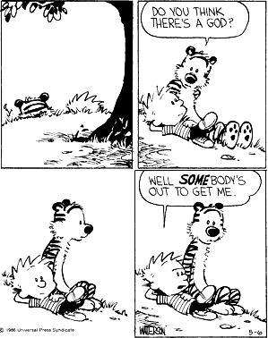
Step 2: Perform a threat analysis
Notes:
A threat analysis is an analysis of who the potential threats are and what their capabilities are.
Need to determine who is out to get us? Who can benefit from getting our information? Who wants it?
What methods do they employ to get our information?
Some common examples include...

Slide 7

The Criminals
Notes:
Financial Gain
- Malware
- Pawn your phone

Slide 8
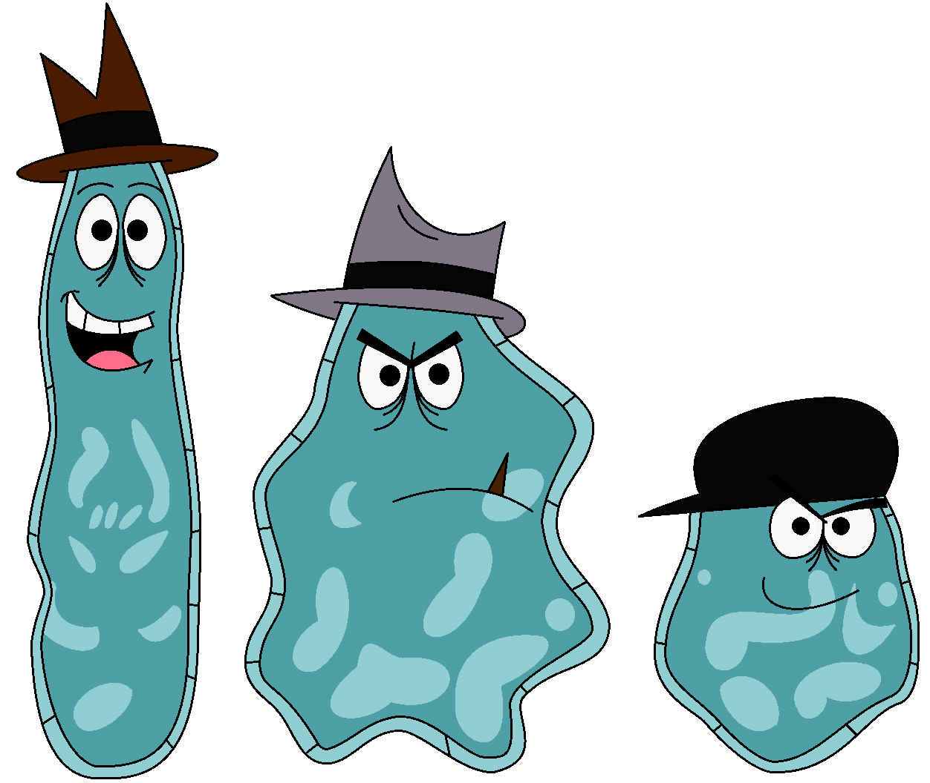
Malware
Notes:
Malicious apps are surprisingly easy to get into the play store.
Google automated the process of vetting apps with an app called bouncer.
Craig Young from Tripwire created StockView

Slide 9

Employers
Notes:
Are monitoring social networks
Often looking for things that are “negative” for the company

Slide 10

Advertisers/Corporations
Notes:
Employ embeded programs and trade services for information.

Slide 11
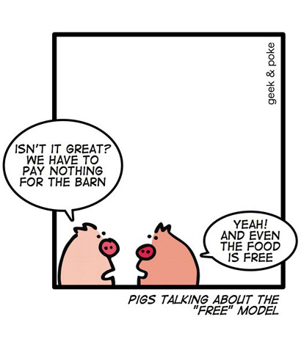
Notes:
Advertisers like to buy and sell you.

Slide 12

Notes:
Whoo boy.
Baked into almost every smartphone developed through early 2012
Could log all keystrokes and send all kinds of data off to Carrier IQ

Slide 13
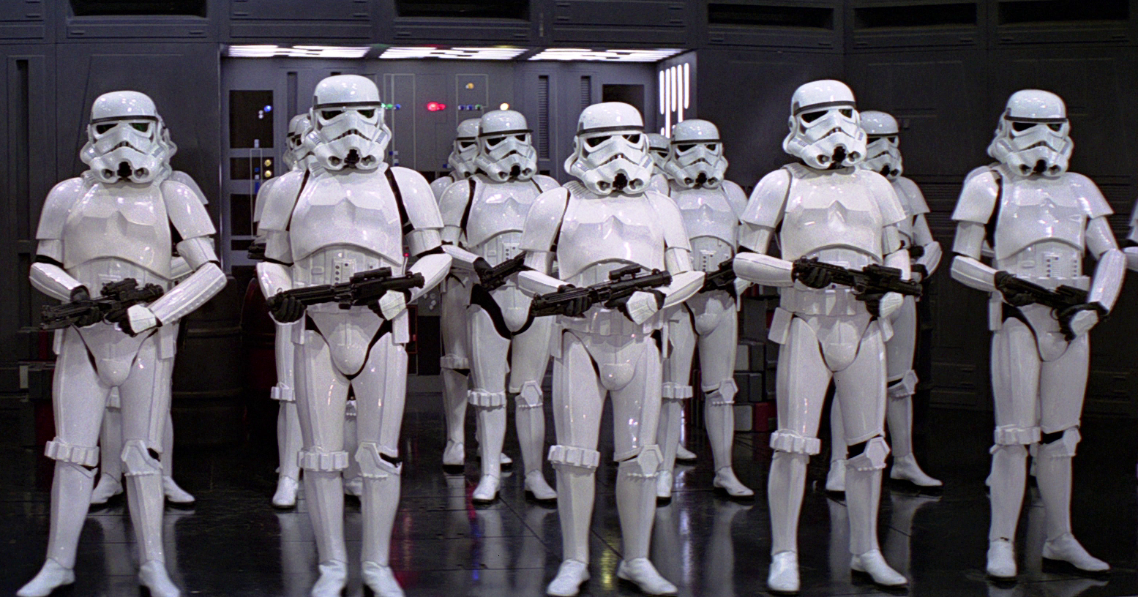
LEO and State Sponsored Surveillance
Notes:
Hardest to overcome.
NSA – Is everywhere
Log everything
Become the object of interest based off who you associate with or your political affiliations
This is not an exhaustive list.. could be parents or teachers. Spouse, sibling (surprise party)

Slide 14
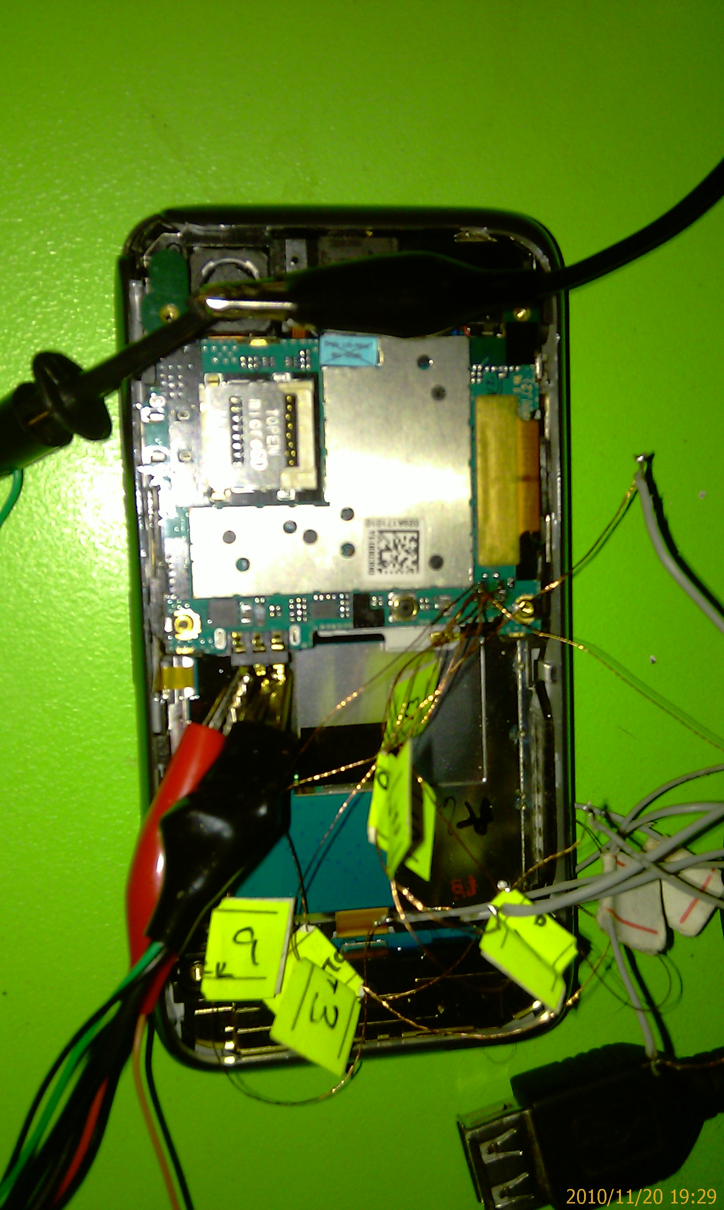
JTAG and UART
Notes:
Methods of getting access to devices via purely physical means.
JTAG requires attaching leads to the motherboard
UART is a device attached to the USB port that allows communications on a hardware level.

Slide 15

Patterns
Notes:
Do you use your phone at the same time every day?
Hezboulah discovered many CIA agents because of routine cell phone usage.
Metadata is King.

Slide 16
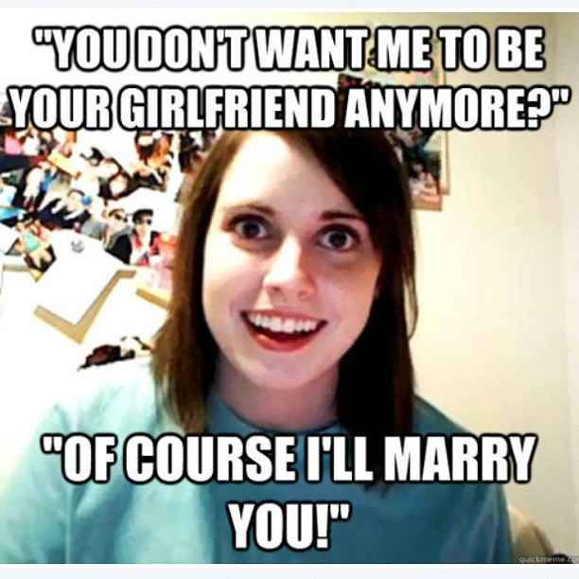
Exes
Notes:
Want to know what you are up to
Depending on who you are and your activities your threat may include your parents, teachers.

Slide 17
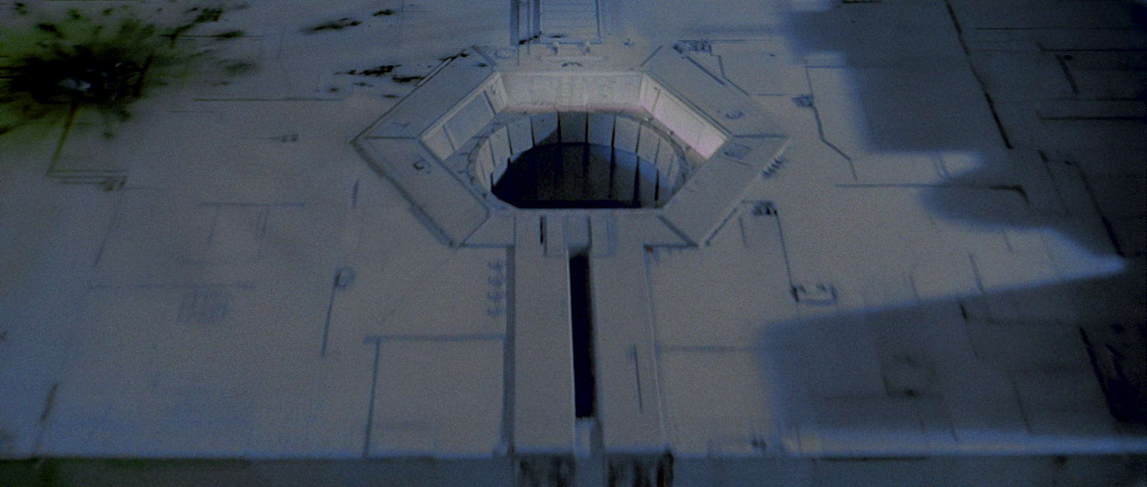
Step 3: Vulnerability Assessment
Notes:
Google Master Skeleton Key
SIM Card Vulnerabilities
Fragmentation
Inconsistent Patching
Poor Application Vetting
Little to no end user education

Slide 18
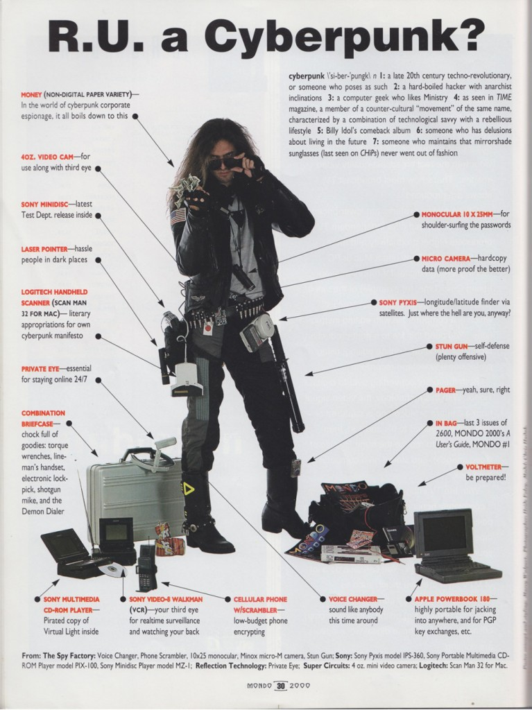
Notes:
3 Axis Accelerometer is some scary stuff
Gus Hunt CIA
70% Accuracy Determine Gender
80% Accuracy Determine Height and Weight
100% Accuracy Determine your Gait
Can track your cell phone with GPS even while powered off
Cellular
2G,3G,4G
WiFi
Bluetooth
FM Radio
Camera
Video
Microphone
3-Axis
GPS
NFC
Digital Compass
Barometer

Slide 19
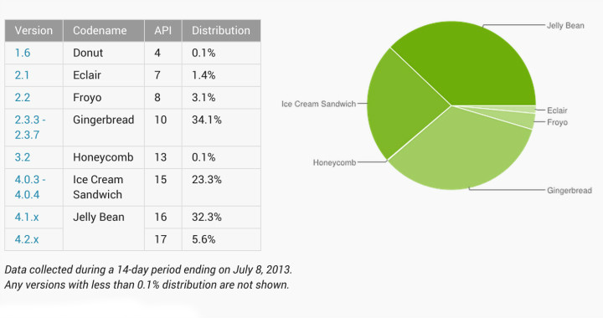
Fragmentation and Patching
Notes:
Common Phones
Motorola Droid X
Evo 4G
Galaxy S2 Epic Touch 4g
Razr
Most of the lower end phones never get support
Mid – High may get 6 months or so patches
Some high end phones can get updates 18 months after (Nexus)

Slide 20

Step 4: Risk Assessment
Notes:
How much damage can be done by your adversary getting the data? Slightly different than threat assessment
Think of it as how bad will your mom cry if this info got out.

Slide 21
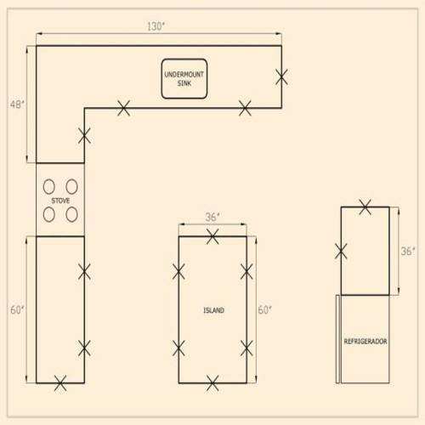
Final Step: Countermeasures!
Notes:
Now that we understand whats important, where it is, who our potential adversaries are, what the potential avenues of leak are, and what the ramifications of the data getting out are we can decide how best to protect that data.

Slide 22
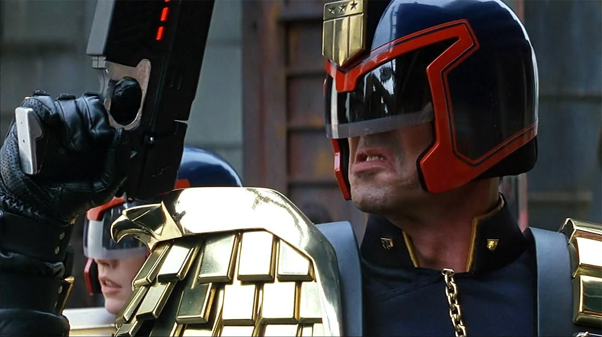
Legal Stuff
Notes:
Consult a lawyer for this.
If you do not have a password LEO can search your phone without a warrant.
LEO cannot compel you to reveal a password. Only a judge can do that.
Having a password implies intent to protect data which can help protect you in legal procedings.
Set a short screen time out so that your phone is effectively always locked
Keep phones that you can pull the battery so that the data partition will become encrypted

Slide 23
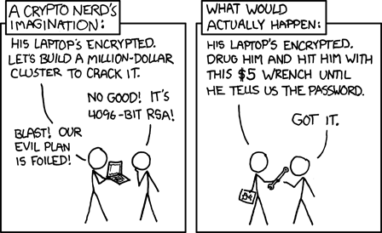
Passwords
Notes:
Picture Lock: The worst. When it first came out it could be defeated with a picture. Linkedin, twitter, facebook
Pattern 350000 combinations, people tend to use similar patterns, right angles, etc Grease attack
Pin 10^16 combinations
Password 2.5 * 10^ 30
Encryption Password is tied to your screen unlock password

Slide 24
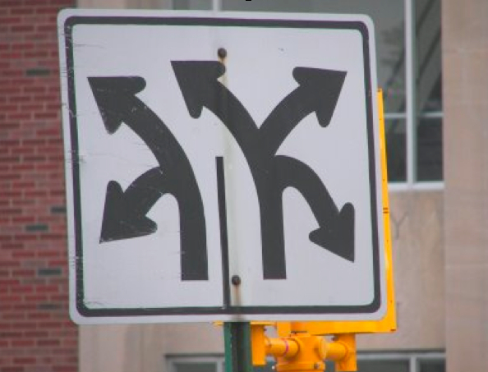
Misdirection and other sneaky shit
Notes:
If you have a burner phone. Plant false data. Make random calls, send random text messages.
If you are going to a sensitive meeting leave the phone at home and take a walk.
Consider planting false contacts and appointments.

Slide 25
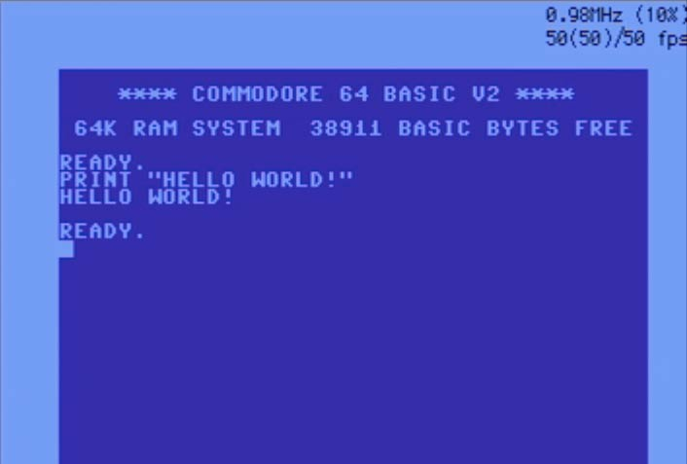
Noteworthy Applications
Notes:
Encryption Encryption Encryption
Iocipher – encrypted folders
Data Partition and SD Card
encrypted text messages
TextSecure
Gibberbot
PGP
SSL
RedPhone
Anti-Virus
Lookout
Droidwall - firewall
Turn Off USB Debugging
F-droid
For the Advanced User
Cyanogenmod – Not practical for everyone.

Slide 26
About Me
Head of IT and Security for RGS Financial, Inc
josh@wtftacos.com
@scottjosh
Dallas CryptoParty
Interested in starting a Memphis CryptoParty? Come find me!
Put this slide deck up on wtftacos.com eventually

